Slide 1
Gaming and Esport

Slide 2
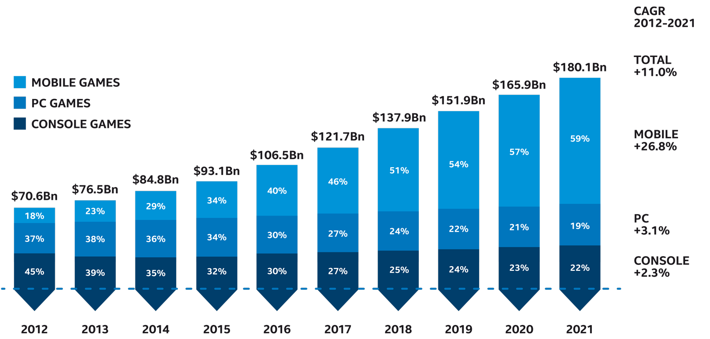
2012-2021 GLOBAL GAMES MARKET
PER SEGMENT
Intel Confidential

Slide 3
Identifying Potential Available Market 2019
+8.6% vs 2018
Total WW Gamers
Total WW PC Gamers
Total WW PC Gamers EXCL browser gamers
Total WW Paying PC Gamers
Source: Newzoo
Total Gamers of 2.5B reduces to 580M after excluding off-target PC gamers (off-targets: Casual web game players only) this is up 8.6% from 2018, from 2017 to 2018 had a larger increase at 8.2%
Note: Paying PC gamer – all people who have spent money to play games on a PC, console, or mobile device. Casual web games - games played on casual games websites or social networkst
Intel Confidential

Slide 4
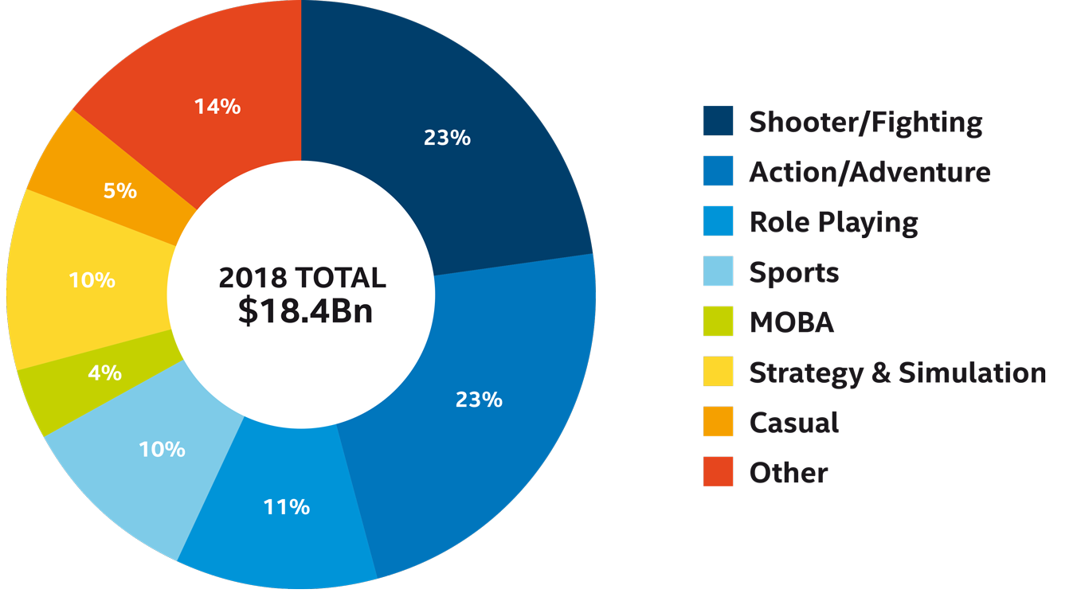
Types of games played on PC
EMEA
Intel Confidential

Slide 5


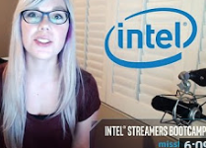





GAMING & ESPORTS MARKETING PLAN
Source: Bain, IDC MBI
Brand
#1 tech brand in eSports
by 2020
Technology
Power eSports end to end
Elevate importance of CPU + VR eSports leadership
Product
Aspirational refresh:
Buy up to a NEW Core i7 PC
Objectives
Increase eSports investment
Elevate IEM; expand to other events
Expand audience reach – 300+ days/year
Platform to accelerate VR playing, viewing &
broadcasts
Influencers
Authentic “Always on”
delivery of Intel message
Strong Microsoft Collaboration
Xbox Play Anywhere
Engineering co-investment
Gaming and eSports joint marketing
AAA Game Enablement
Enabling and authentic and relevant
co-marketing
Integration from ATL to retail

Slide 6
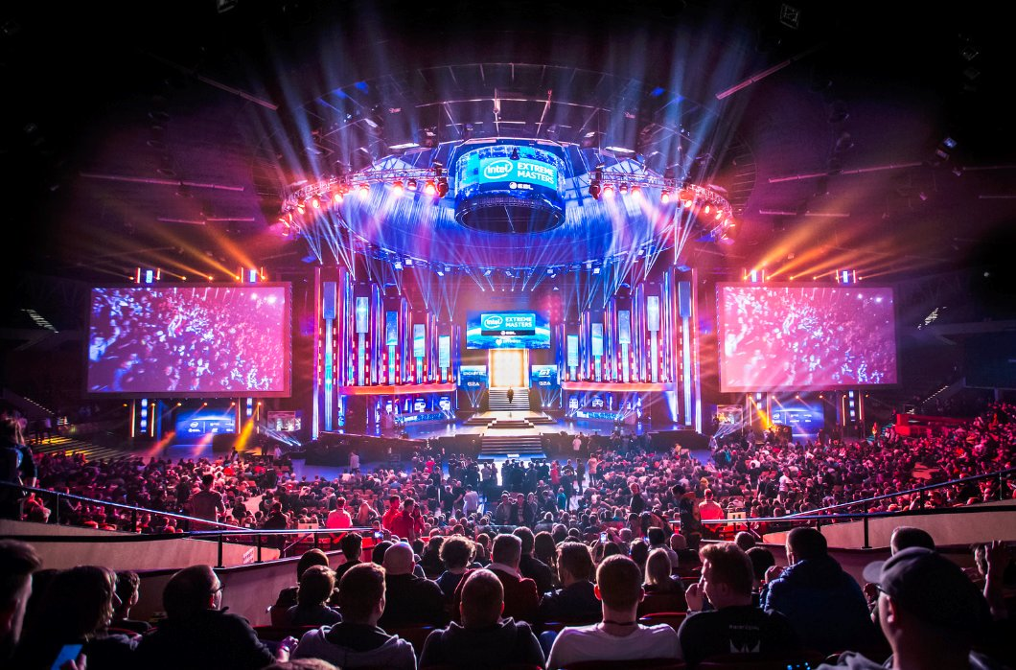



eSports and Broadcasting Have Massive Reach
eSports Audience
  Estimated 345M viewers by 2019
  IEM Reaches ~20% of TAM
  North America and Europe are the two biggest markets accounting for over half of the total global Esports revenue
Broadcasting
  100M+ unique monthly active streams
  20B+ minutes viewed per month

Slide 7
Esports Audience
316m
“The increasing exposure of Esports
as a mainstream entertainment industry is driving the growth in awareness
in most regions”
– Newzoo 2018 Global Esports Market Report
285m
253m
222m
192m
160m
264m
233m
201M
143M
173M
121M
Source: Newzoo
Esports Enthusiasts will grow at a CAGR of 16.9% from 2016-2021 and Occasional Viewers will grow at a CAGR of 14.6%
Source: Newzoo
Intel Confidential

Slide 8











Esports revenue growth
$1662.7m
The entrance of non-endemic brands into
the Esports space as well as exclusive content deals, drive the surge in revenue growth from sponsorship and media rights
$1455.9m
$1170.4m
$900.1m
$655.3M
$492.7M
Source: Newzoo
Esports revenue will grow at a CARG of 27.5% between 2016-2021.

Slide 9
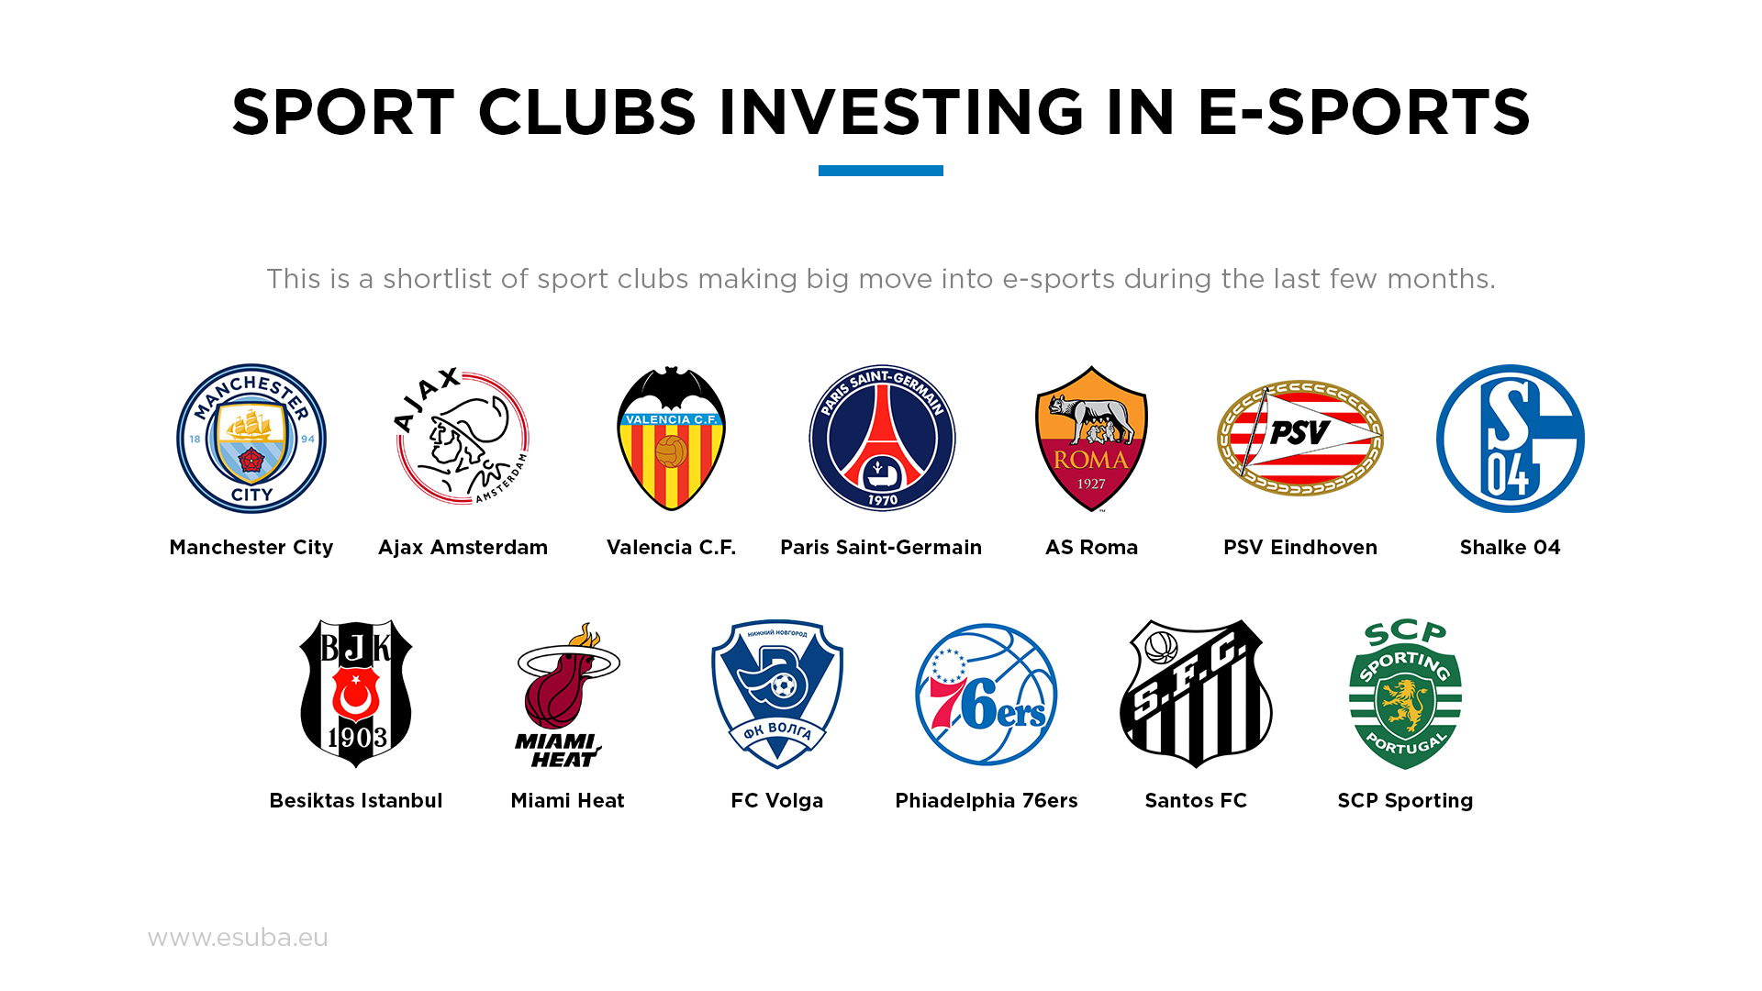

Slide 10
Global Esports Influenced PC Gaming Hardware Sales*
$ Millions US / 42% CAGR
Esports is creating new PC hardware sales by bringing new customers into the market who discover gaming through team sponsorships and non-endemic advertising and encouraging them to buy up.
*Notes: Sales of PC hardware influenced by Esports, system upgrades that can be attributed to HW sponsorships in Esports
Notes:
How did JPR arrive at these figures? And are these numbers in thousands, millions, ASP per esports fan, etc.?
TIBURON, Calif., July 11, 2017 (GLOBE NEWSWIRE) -- Technology management consulting firm Jon Peddie Research has added an eSports hardware analysis to its PC Gaming Hardware report series and forecasts the market to reach $856 million in 2017. Growing at a blistering 42% CAGR, eSports influenced PC Hardware purchases will reach over $2.2 billion in annual sales by 2020.
Sales chart: http://www.globenewswire.com/NewsRoom/AttachmentNg/1bda36ba-a9dd-46cf-84b7-f15ea4999b11
Ted Pollak, JPR Senior Video Game Industry Analyst said, “Much of the current eSports research focuses on advertising and event revenue as well as game sales influenced by eSports tournament creation or adoption. Often overlooked is the fact that eSports is increasing hardware revenue in multiple ways. The first and most important factor is that eSports is minting new customers. Their initial system and peripheral purchases often measure over a thousand dollars. Additionally, hardware marketing via team sponsorships are encouraging new and existing gamers to select better parts and accelerate upgrades and rebuilds which also enhances the market.”
From high refresh/resolution displays, to mice and keyboards, to headsets and entire systems, the eSports influenced PC Gaming Hardware market comes in many forms.
Jon Peddie, President of JPR noted, “Our analysis not only measures eSports influence across hardware segments, but it drills down to pricing tiers within each segment and does this for all major geographic regions globally. If one adds our data to even the most conservative advertising, software, and event revenue, the market has already breached $1.5 billion. eSports is about and for the gaming community, not just who’s selling ads, or running conferences.”

Slide 11



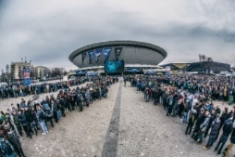




















Intel esports leadership
Legends
IEM Kings of eSports
The pinnacle of esports achievement.
Rare, unique and epic.
Seoul, Korea
US West
Shanghai China
Katowice, Poland
Pro-Gamers
Global narrative into IEM
Las Vegas
Malaysia
Australia
Sweden
Dallas
All A+ Pro events ladder into IEM.
Expand the volume of Intel content.
Germany
Germany
NYC
France
Denmark
200M+
Amateurs
Engage Top to Bottom
audience
reach
365
DAYS
9x
Directly engage the gaming community
every day, everywhere, always on.
Influencers & eSports Teams
Intel Confidential

Slide 12
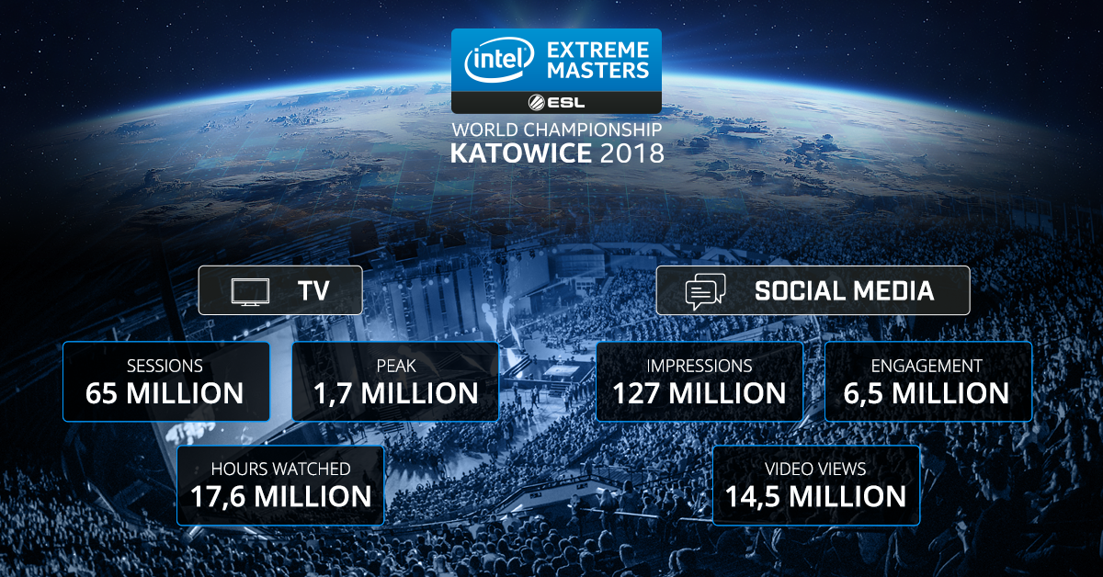

Slide 13

Twitch Streaming overview – 2018 to Oct’18
People spend more time online than they do watching TV.
Most popular titles by hours watched (Mil)
Total hours watched (B)
9.8B
Avg daily hours watched
22.3m
Top channel by hours watched
Ninja 225Mil
Source: Newzoo
Fortnite has been dominating the streaming scene since the start of the year and show little signs of slowing down, almost 15% of all hours streamed in 2018 are of Fortnite alone

Slide 14

youtube Streaming overview – 2018 to oct’18
Every 70th person on the planet Earth
watched LCS Finals 2016.
Total hours watched (Mil)
Most popular titles by hours watched (Mil)
1808M
Avg daily hours watched
4.07m
TOP CHANNEL BY HOURS WATCHED
Lol esports 62.1 Mil
Source: Newzoo
YouTube steaming is not as popular as Twitch with less than 20% 0f the streaming hours that Twitch has. Some streamers are moving to YouTube and Facebook

Slide 15


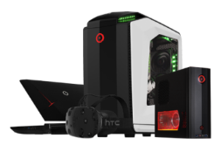
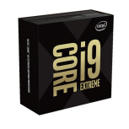
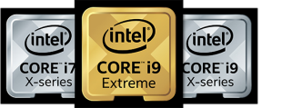







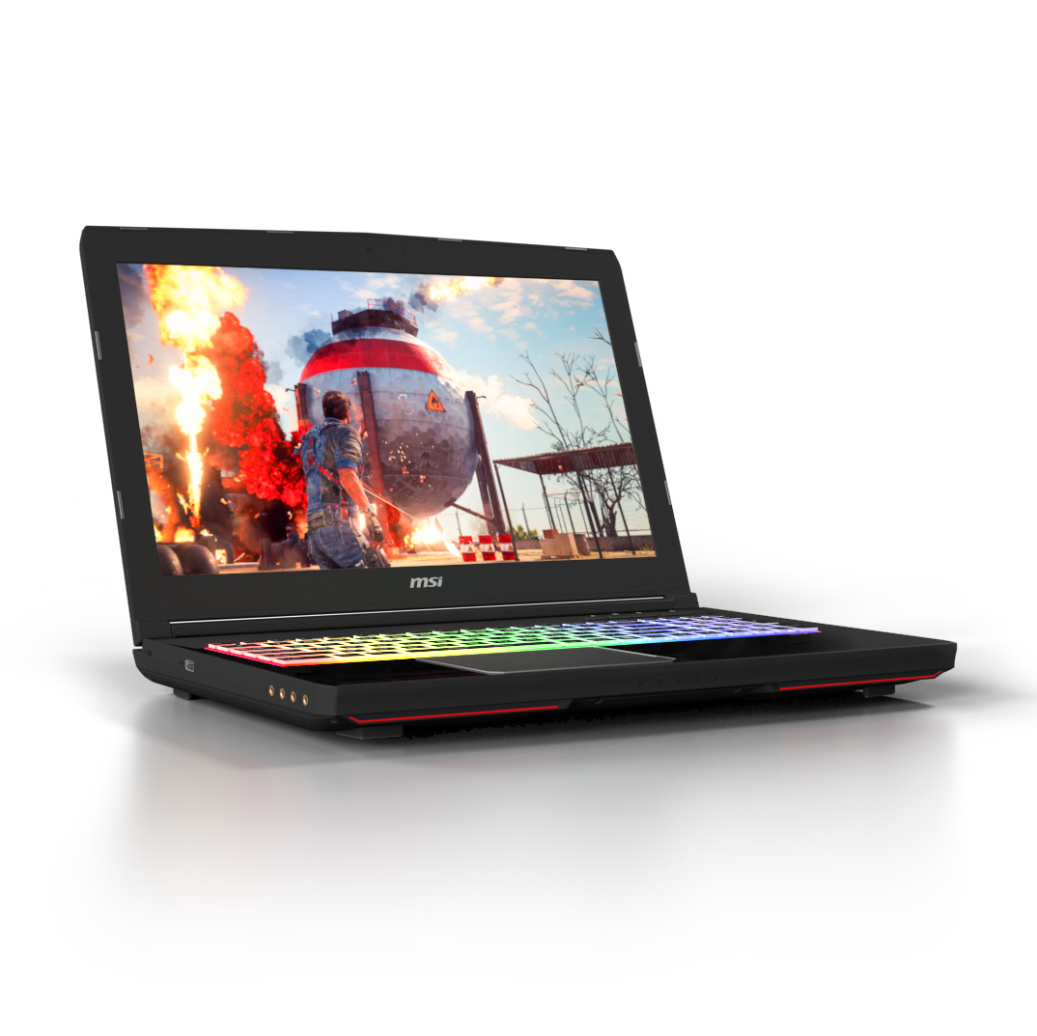

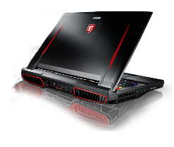
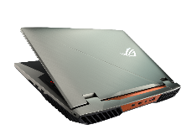
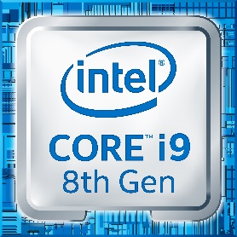



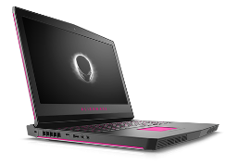
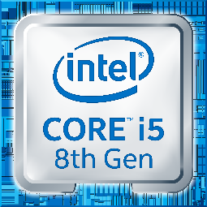
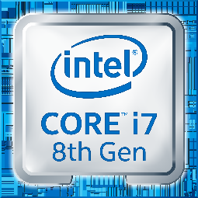
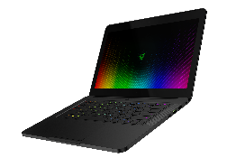
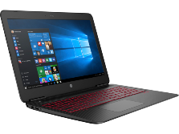








Gaming Segmentation
HW Recommendation
PC System Types & Gamer Segments
K-CPU and X-Series for maximum performance and megatasking
Desktop systems for the DIY crowd, often sold through the channel;highend gaming notebooks for the enthusiast crowd including streamers
Streamers, 4K gamers, VR gaming
Enthusiast
Core i9 or i7 H/K/S CPU paired with high-end GFX
Desktop or Gaming laptop
Hardcore
Gamers
MOBA
Players
Systems for gamers willing to pay for better performance
AAA games players; many games installed and played; Ultra GFX settings is a must
Core i5 or i7 slim NTB or
small form factor PCs
or NUC
Systems for popular eSports titles and capable to play the rest
Full HD enough; compromised settings accepted
Casual Gamers
(Users play games but not the primary use case or play mobile games)

Slide 16
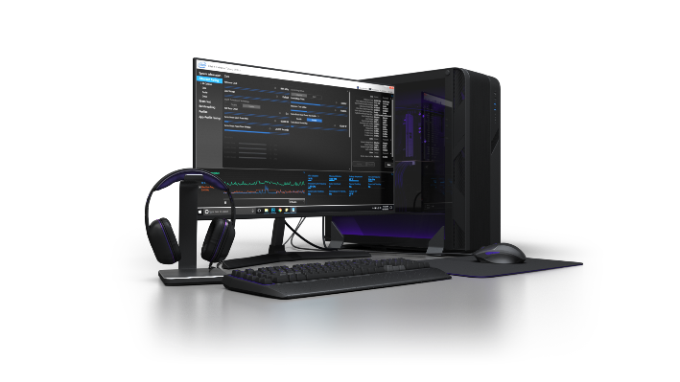
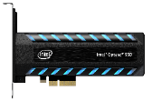

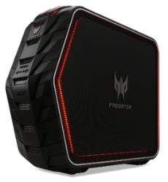
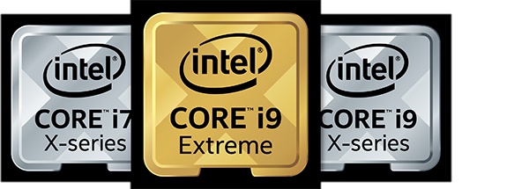

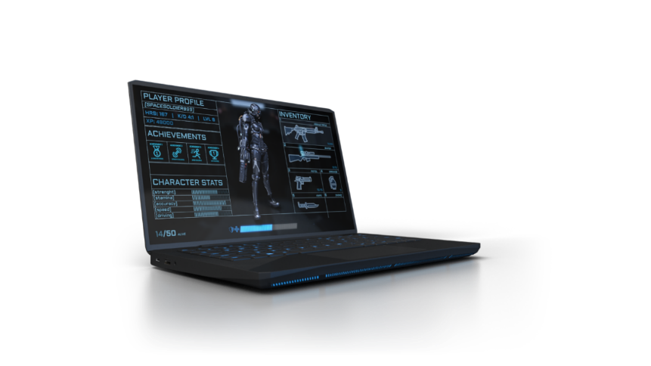
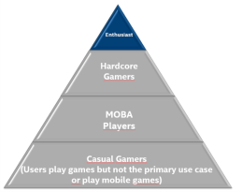
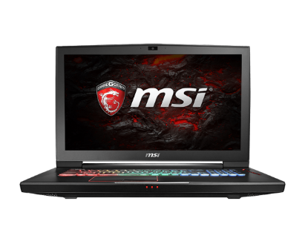
Gamer segments - enthusiast
Gaming is their primary hobby – playing games 6+ hrs every day
Gaming is their job – working as a streamer, professional esport gamer
Needs the best of the best – whatever it costs if it brings extra FPS/performance
Keen on trying new trends in gaming like VR, 4K, 8K, RTX – they already have HW that is able to run everything
Updating their HW very often – primary gaming/streaming machine is PC, can have gaming laptop as secondary device

Slide 17

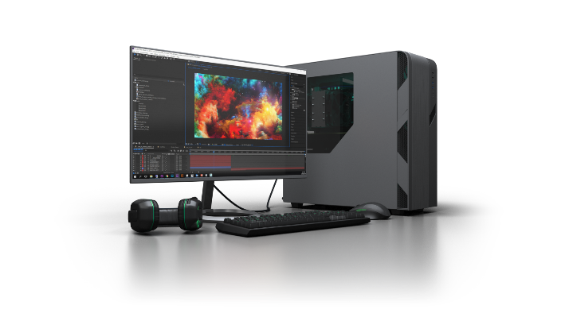
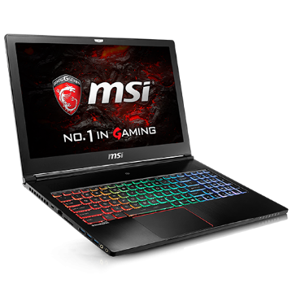
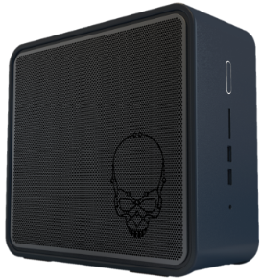
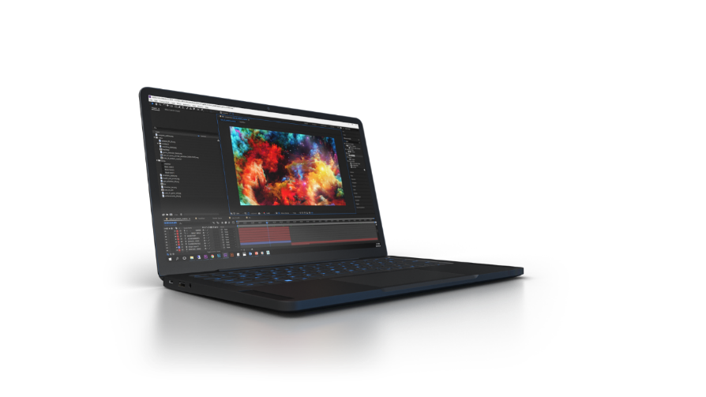
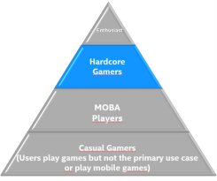
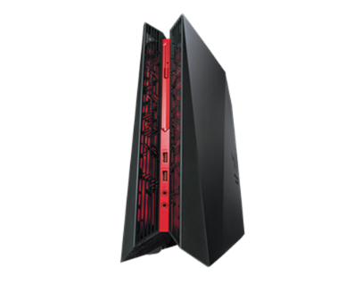
Gamer segments – hardcore gamers
Take gaming very seriously – playing games 4-6 hrs a day on average
Gaming is not their job but might be
Usually plays many different games – FPS, MOBA, racing, strategy... Not focused on single game only.
Enjoying playing games on high GFX setting that looks „cool“
Updating their HW according to how game graphics is evolving. Price-performance is important
Gaming device can be PC or gaming laptop

Slide 18


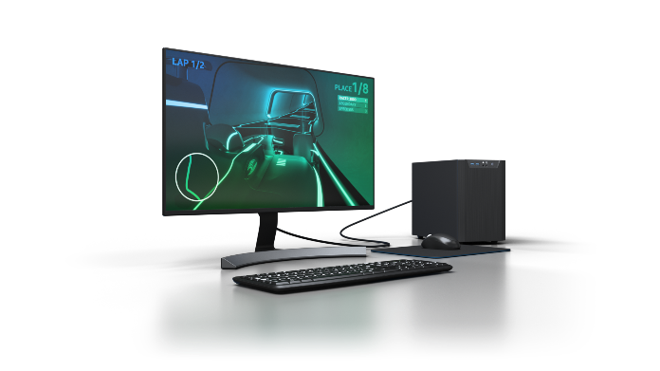
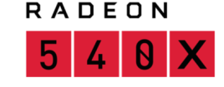
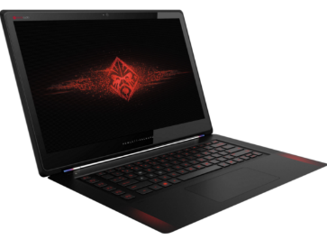
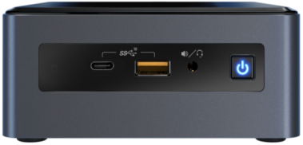
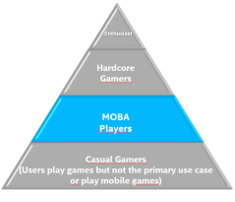
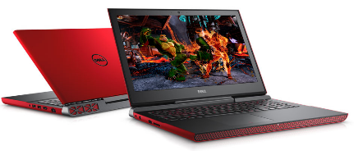
Gamer segments – Moba Players
Focused solely on playing massive multiplayer competitive games like LOL, WOW, PUBG, Fortnite, CS, WOT etc.
Time spent by gaming varies – can be 6+ hrs a day
Usually focused on one single game but can move from one game to another over time
Higher spending's on ingame content
GFX setting not so important – seamless playing 100+ FPS is the most important
These games are mostly less demanding for HW to be playable on the most PCs/NTBs
More preferable is NTB so they can play anywhere, anytime – thin portable design is valued

Slide 19

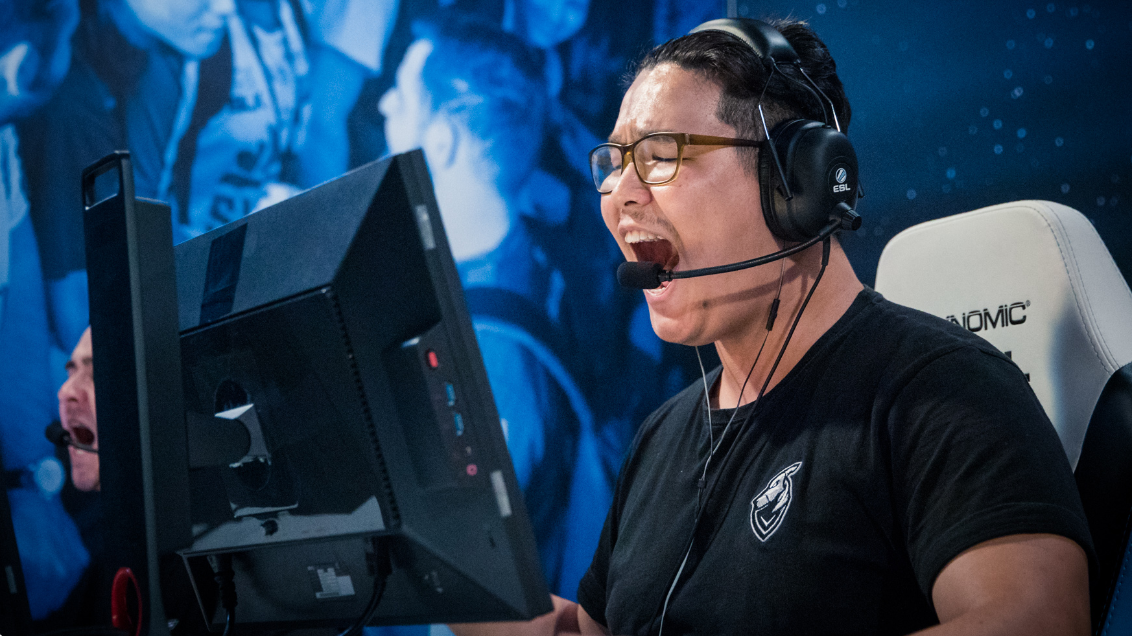
          Why Does
          Hardware
          Matter?
Intel Confidential – Shared Under NDA
Notes:
So let’s talk about the hardware

Slide 20


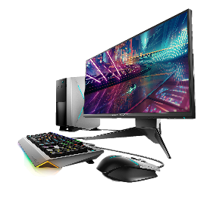


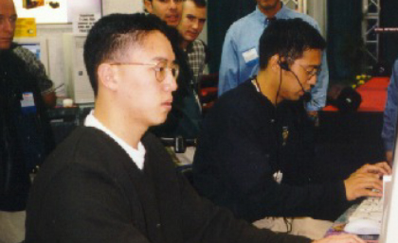



When Hardware Improves -
Software, Content & Experiences are transformed
1990’s
2000’s
2010’s
LAN PARTIES
INTERNET BOOM
Esports/LIVE STREAMING
Intel Confidential – Shared Under NDA
Notes:
Let’s go back in history a bit, about a decade before we started IEM.
If you’re my age you may remember LAN parties when we’d drag our desktop PCs to a basement somewhere and wire them all together, playing some of the original multiplayer games like Unreal, Quake, and an early Half Life mod called Counterstrike.
That was fun but things got better with broadband in the early 00s, no more dragging was required and we could play anyone anywhere, any time. Live events were still happening though, including the first IEM in 2006.
The last piece that really created esports was live streaming, allowing there to be a worldwide audience, creating a sustainable esports scene that leads to real money for players and businesses.
So what allowed the innovations that led to modern esports? The power and openness of the PC. Hardware advances over the past 2 decades have paved the way for new software and new services that take advantage of the improved performance and new capabilities.
And we’re continuing to deliver innovation and performance.

Slide 21

Maximize gaming with 9th Gen Intel® Core™ Desktop Processors
The most powerful generation of Intel® Core™ desktop processors
Up to 8 cores, 16 threads, 5.0 GHz, 16 MB cache, and 40 platform PCIe lanes
Intel Confidential – Shared Under NDA
Notes:
Our newest product for gamers is the 9th gen Core i9-9900K we just launched last month. This continues an annual cadence we’ve been on the past few years, adding cores, threads, frequency and platform benefits for desktop gamers who want the best gaming CPU ever made.

Slide 22





Providing BREAKTHROUGH PERFORMANCE
WORLD OF TANKS ENCORE
HITMAN 2
TOTAL WAR: WARHAMMER II
CONQUEROR’S BLADE
UP TO
UP TO
UP TO
UP TO
10%
BETTER
PERFORMANCE
10%
MORE
FPS
11%
MORE
FPS
11%
BETTER
PERFORMANCE
vs. previous gen⁸
vs. previous gen¹⁰
vs. previous gen¹²
vs. previous gen¹⁴
UP TO
UP TO
UP TO
UP TO
37%
BETTER
PERFORMANCE
38%
MORE
FPS
40%
MORE
FPS
45%
BETTER
PERFORMANCE
vs. 3-year old PC⁹
vs. 3-year old PC¹¹
vs. 3-year oldPC¹³
vs. 3-year old PC¹⁵
Performance results are based on testing as of October 2, 2018 and may not reflect all publicly available security updates. See configuration disclosure for details. No product can be absolutely secure.
Software and workloads used in performance tests may have been optimized for performance only on Intel microprocessors. Performance tests, such as SYSmark and MobileMark, are measured using specific computer systems, components, software, operations and functions. Any change to any of those factors may cause the results to vary. You should consult other information and performance tests to assist you in fully evaluating your contemplated purchases, including the performance of that product when combined with other products. For more complete information about performance and benchmark results, visit http://www.intel.com/benchmarks.
*Other names and brands may be claimed as the property of others.
Intel Confidential – Shared Under NDA
Notes:
Let’s look at the performance benefits of the Core i9-9900K
Here are 4 gaming titles, and we’re comparing the i9-9900K with both the 8th Gen Core i7-8700K, as well as a i7-6700K from 3 years ago.
Bottom line is double digit performance gains vs. 1 year ago and about 40% gains vs. 3 years ago.
--WoT: In-game benchmark points
--Hitman 2, Conqueror’s Blade: median FPS during in-game benchmark mode
--Total War: median FPS while gaming/recording/streaming
For those who like to later edit their videos, we measured the video editing capabilities of this platform using Adobe Premier Pro. For video editing, the i9-9900K was 34% faster than the i7-8700K, and 2x vs. the 3yr old PC.

Slide 23
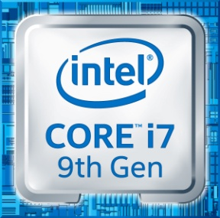
9th Gen Intel® Core™ MOBILE ProcessorS
the most powerful generation of Intel® Core™ mobile processors ever
Enthusiast
Gaming
Content
Creation
Overall
Performance
GAME FPS
GAME TURN TIME
Editing
PERFORMANCE
Up to
5
Up to
6
Up to
7
Up to
8
vs.
3 year old system
56%
38%
54%
33%
FASTER
FASTER
FASTER
BETTER
4K video Editing
Amazing PERFORMANCE leap vs 3-year Old ENTHUSIAST pc
Performance results based on testing which concluded April 12, 2019 and may not reflect all publicly available security updates. See configuration disclosure for details. No product can be absolutely secure.
Software and workloads used in performance tests may have been optimized for performance only on Intel® microprocessors. Performance tests, such as SYSmark and MobileMark, are measured using specific computer systems, components, software, operations and functions. Any change to any of those factors may cause the results to vary. You should consult other information and performance tests to assist you in fully evaluating your contemplated purchases, including the performance of that product when combined with other products. For more complete information visit www.intel.com/benchmarks.

Slide 24






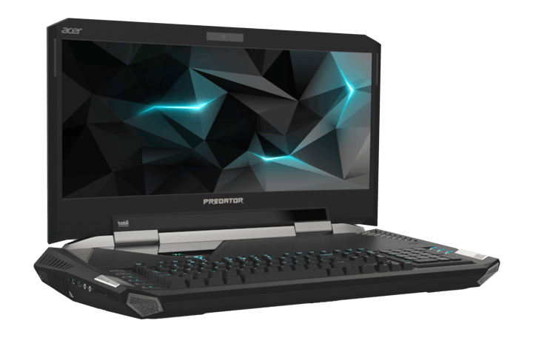
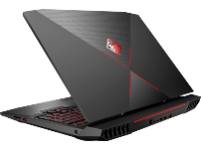
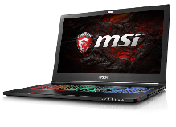





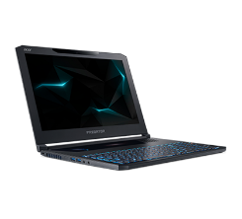
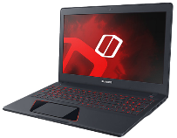
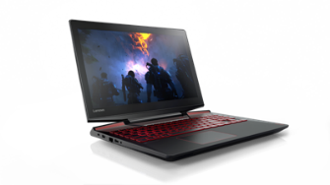
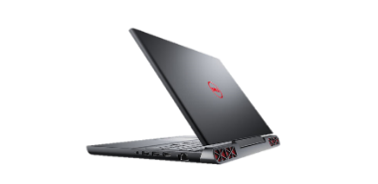
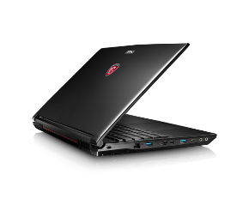

mobile GAMING solution for every Player
Muscle books
H-Series
Slim gaming laptops
H-Series
PRICE
Performance gaming laptops
H-Series
Notes:
So let’s talk notebooks.
We look at gaming NB in 3 categories. Musclebooks used to be the main type of gaming notebook, and they remain the top of the performance lineup.
In Musclebooks you’ll find overclocked CPUs, mechanical keyboard, HDR / high refresh screens, eye trackers.
Right alongside the musclebooks is the new slim gaming category. This was created because everyone wants gaming performance without sacrificing weight and battery life, so it’s been a real focus area for us and for Nvidia the past couple of years.
In these machines you’ll also find amazing screens, tiny bezels (85% screen to body), thin Z height, small power adapters, 8+ hours battery. IMO this will be the area of continued innovation as we try to find the balance between performance and size.
Sitting below both of these pricewise is the standard performance gaming lineup,

Slide 25
Global Notebook PC Gaming HW Revenue
Global desktop PC Gaming HW Revenue
Notebook Systems Global Revenue (in USD $M)
Desktop Systems Global Revenue (in USD $M)
Entry-Level: <$1000*
Mid-Range: $1000-$1800*
High-End: >$1800*
* Includes any amortized display value

Slide 26














Intel platform inovation
Optane™ memory solutions for up to 65% faster load times than
HDDs and 2,29x faster game level load then 3yrs old TLC SSD
Thunderbolt™ 3 – more mobile gaming possibilities
Accelerating VR adoption with WiGig, inside out 6DoF
tracking, HMD offload, and more
Intel Performance Maximizer is a new innovative software tool
that opens up the performance of overclocking to a whole new
segment of gamers
The Intel Easy Streaming Wizard helps users quickly and easily install and configure Open Broadcaster Software (OBS)
Enablement and Marketing Collaborations FOR AAA and VR Games
Notes:
Intel is also offering innovative software products that improve the gaming experience.
Intel Performance Maximizer is a new innovative software tool that opens up the performance of overclocking to a whole new segment of gamers.
In the past, if a user wanted to overclock their CPU for maximum performance, they often needed custom cooling and archaic software tools at a minimum.
With Intel Performance Maximizer, a simple one-button interface provides a personalized performance boost, self-monitoring and peace of mind so gamers can make the most of their 9th Gen unlocked desktop CPUs.
And as mentioned earlier, community is super important to this audience.
Streaming game play to services like Twitch, YouTube, or Mixer is necessary for the gamer.
The Intel Easy Streaming Wizard helps users quickly and easily install and configure Open Broadcaster Software (OBS)
This minimizes confusion and allows gamers to start streaming to their community in minutes, not hours or days.
Intel innovations, not just in the processor, but in memory, connectivity and software, enables amazing immersive game play.

Slide 27








Cloud Gaming
What is cloud gaming? The ability to play a game on a device without owning the physical hardware required to process it or needing a local copy of the game itself
How does it work? The bulk of the game computation executes on a remote machine (i.e. cloud) and the I/O (screen, KB/M, gamepad) takes place on the local machine
Market analyst growth forecasts vary…
$2.2B in 2021 per KSI
$1.8B in 2021 per TechNavio
$7B in 2026 per Zion Market Research
Witcher 3 on a Chromebook
Tomb Raider on a smartphone
Stadia GDC ’19 announcement
Highlights from mobile cloud gaming ad
CLIENT COMPUTING GROUP | Intel® Confidential

Slide 28












Types of Cloud Gaming
Video Frame Streaming | Game is completely run and rendered in the data center, and the transcoded frames are broadcast to the end user device. The client decodes video locally. Most common interpretation of “cloud gaming”.
Command Streaming | Game logic is run in the data center but graphically rendered on the local client device. Algorithms stream graphics commands to the client to determine what to draw and render.
Tech giants and startups alike are deploying services to test and learn fast.
Initial testing grounds do not limit the architecture to stay bounded in one lane.
CLIENT COMPUTING GROUP | Intel® Confidential

Slide 29







End User Challenges & Pain Points
Tech Literacy
Cost To Play
Parental Control
Avoid hardware upgrades, cable installs, software installations, driver updates, etc.
Can’t afford a $1200 gaming tower? Use your 5-year-old laptop and pay a monthly fee
Controlling what and for how long your children play
Immediacy
Mobility & Any Device
Security
Skip the long download times after purchase. No more weekly game patches/fixes. Demo a game in seconds.
Console & PC-level gaming experiences on-the-go. Play on the device form factor of your choice
Deterrent against hacks and cheats
Theoretically addresses many pain points for end users, but multiple technical and business limitations remain. Cloud gaming will add
to (not replace) the variety of ways to play games.
CLIENT COMPUTING GROUP | Intel® Confidential
Notes:
Intel POV on challenges below:
Tech Literacy: Not all cloud gaming services are equal. Some provide a hosted PC experience in the cloud, thus demanding a similar level of tech literacy to get your games up and running.
Immediacy: This is a universally appreciated benefit cloud gaming will bring
Cost To Play: The economics and cost-of-ownership are unproven given many services’ prices are unknown or untested.
Mobility: Data constraints on ISP plans, battery life for mobile devices, and input ergonomics are all factors that can limit this reality.

Slide 30












Intel delivers the best gaming experiences on the planet
Delivering the highest performance
Expanding the world of eSports
The most powerful generation of Intel® Core™ desktop processor – i9-9900K
Extreme Edition processors with up to 18 cores,
44 PCIe lanes, and Turbo Boost Max 3.0
9th Gen Intel® Core™ MOBILE Processor - the most powerful generation of Intel® Core™ mobile processors ever
Driving global and regional tournaments for the definitive eSports narrative with Intel Extreme Masters
173,000 global event attendees, 340,000 unique VR viewers, 46M total online views, for IEM Katowice 2017
Empowering influencers to engage directly with gaming communities, everyday, everywhere, always on
Innovating in VR and other technologies
Powering cloud and gaming services
Powering premium PC VR solutions (Oculus Rift, HTC Vive) and upcoming Windows Mixed Reality
Accelerating VR adoption with WiGig, inside out 6DoF tracking, HMD offload, and more
Optane™ memory solutions for up to 65% faster load times than HDDs and up to 2X faster boot times
Explosion of data with broadcasting services like Twitch*, YouTube*, Beam*, and others
Viewers spent 292 billion minutes watching Twitch in 2016, fueling massive appetite for data centers
Game streaming, cloud-enabled rendering and object destruction, and other cloud usages on the rise
*Other names and brands may be claimed as the property of others

Slide 31
Back up

Slide 32

Game Enthusiasts
Non-buyers do not purchase their own hardware.
Indifferent Owners see hardware mostly as necessary requirement for playing. They do not take gaming into account when buying new hardware and will only buy new hardware when really needed.
Dedicated Owners see the value of gaming hardware in enhancing their gaming experience. They take gaming into account when buying new hardware but will choose high-value-for-money options.
Fanatic Owners are passionate about hardware and consider hardware to be a core part of their gaming experience. They want the best hardware setup available and will frequently upgrade to make sure they have it.
Intel Confidential

Slide 33






Google & Microsoft Investments In Cloud Gaming
Project xCloud
Stated Mission: “Give players instant access to a game by clicking
a link for instant access…”
Cloud gaming (frame streaming) capable of 4K@60fps, HDR
  Accessible via Chrome browser; integration with YouTube
  Optional proprietary controller w/ direct Wi-Fi link to DC
  Custom AMD GPU w/ HBM2 memory, 10.7 TFLOPS
Still unknown or TBA:
  Network requirements
  Pricing structure / business model
Stated Mission: “Play the Games you want, with the People you want, on the Devices you want”
Put HW into the cloud (Xbox into racks)
Provide services that enable streaming of those games (xCloud)
Provide tools to fine tune experiences and adapt to new devices (phones)
Offer Microsoft level scale (Azure)
Why? Move $$$ of gaming HW/SW revenue from
Sony/MSFT/Nintendo/Apple/Valve
to Google
Why? Azure growth driver. Gives MSFT in with mobile gamers. Keep developers building on WinOS via toolkits that leverage existing code
CLIENT COMPUTING GROUP | Intel® Confidential

Slide 34







Thunderbolt™ 3 – more mobile gaming possibilities
Gaming
Displays
Game Capture
& Media Libraries
External
Graphics & VR
Networking
Media Creation
& Drones
IEM
Chicago 2018
Intel Confidential – Shared Under NDA
Notes:
The final technology I’ll mention is Thunderbolt, now in it’s third generation. You’re starting to see these ports more and more, primarily on notebooks, with several use cases:
Gaming displays
External storage
External graphics

Slide 35

Further improving mobile gaming experience
Intel® Optane™ memory H10 with solid state storage
Play
LOAD
LEVELS
Create
OPEN LARGE
MEDIA FILES
2.29x
1.63x
Up to
9
Up to
10
Now featuring Intel® Optane™ memory H10 with SSD, 9th Gen Intel® Core™ delivers even greater performance.
FASTER
FASTER
Compared to a 3-Year old system with an TLC SSD.
Compared to a 3-Year old system with an TLC SSD.
* NOT all features available on all SKUs
Performance results are based on testing as of March 22nd, 2019, and may not reflect all publicly available security updates. See configuration disclosure for details. No product can be absolutely secure.
Software and workloads used in performance tests may have been optimized for performance only on Intel microprocessors.
Performance tests, such as SYSmark and MobileMark, are measured using specific computer systems, components, software, operations and functions. Any change to any of those factors may cause the results to vary. You should consult
other information and performance tests to assist you in fully evaluating your contemplated purchases, including the performance of that product when combined with other products. For more complete information about performance
and benchmark results, visit http://www.intel.com/benchmarks

Slide 36

Global games market trends
We are here
We have everything needed to be here
We have to be here

